Slide 1
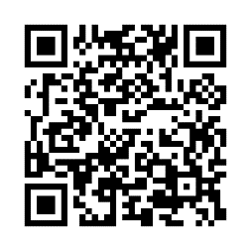
Complete a coaching session to earn points
Health coaching guide
Let’s face it. Getting healthier can be challenging! Starting 2/1 you can request one-on-one support from a qualified coach—right from the Virgin Pulse website or app. A coach can motivate you, give you tips and help you reach your goals. What are you waiting for? Start working with a coach today!
Schedule a session today!
Visit member.virginpulse.com, go to the Health tab and select Coaching, or scan the QR code to open in your app.
Not a member yet?
Don’t miss out on all the fun! Get started today by going to join.virginpulse.com/bcbsri
© Virgin Pulse 2023

Slide 2
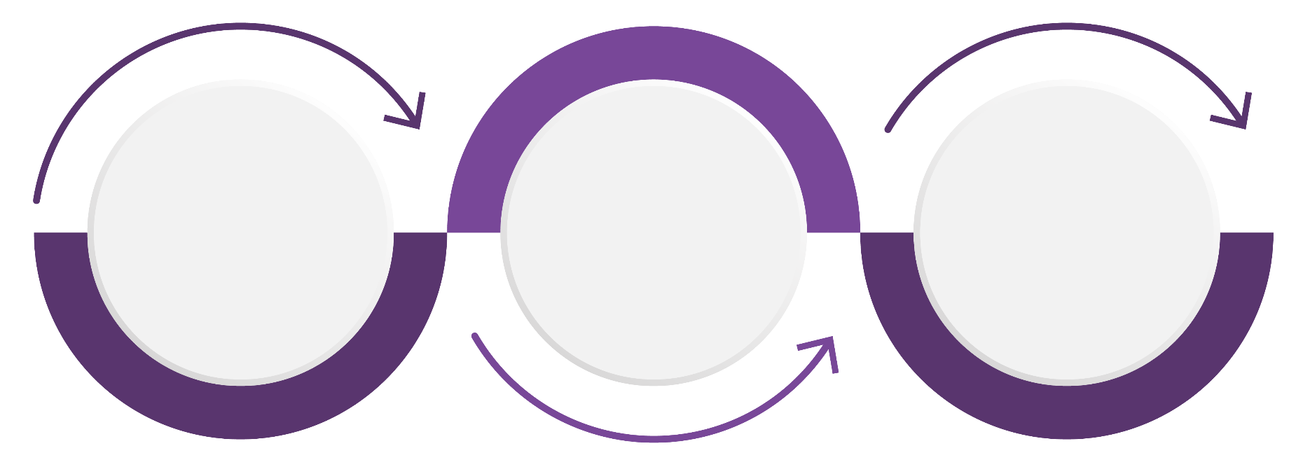
Reach your health goals, together
Making changes to your health routine isn’t always easy. Whether you’re starting to exercise, training for a marathon or anything in between, our health coaches help motivate and encourage you along the way. Connect with a coach to set goals, monitor your progress and get extra tips to keep going.
What to expect
Your first session will help you build a meaningful relationship with your coach. Together, you’ll work to find small steps you can take to make progress toward your goal. During your follow-up sessions, you’ll update your coach on your progress and plan next steps to help you stay on track.
1. Set a goal
Are you trying to get fit, eat healthier or sleep better? Your coach can help you set a goal and stay with it.
2. Monitor your progress
Coaches can see how you’re doing and offer tips to help you do even better.
3. Get support & encouragement
Chat with your coach online or via our app, and get personal, encouraging messages.
Coaching topics
Choose a topic that you’d like to cover with your coach, such as Get Active, Eat Healthy, Reduce Stress, Manage Weight, Sleep Well or Be Tobacco-Free.
© Virgin Pulse 2023

Slide 3
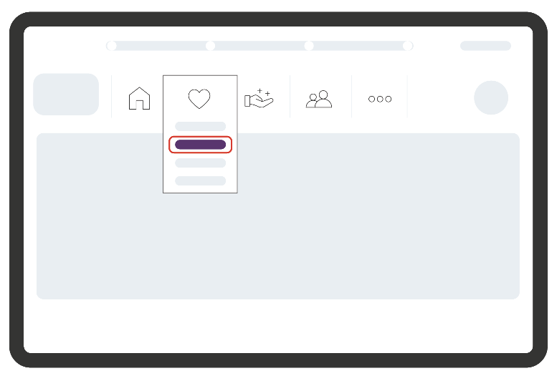
How to get started
Step 1 Once you’re signed in, go to the Health tab and select Coaching. If you have the app, just scan the QR code:
Step 2 Select Schedule a Session and then pick your preferred topic by clicking an image.
“Having someone to talk to actually made me enthused to take these simple, easy steps. I am gradually feeling less stressed, and I’m motivated to continue.”
— Rosie
Step 3 Choose an available date and time that works for you.
Step 4 Enter your phone number, and click Confirm Appointment.
Have questions? We’re here to help.
• Check out support.virginpulse.com Live chat: Monday–Friday, 2 am–9 pm ET
• Give us a call: 1-855-914-2478 Monday–Friday, 8 am–9 pm ET
• Send us an email: support@virginpulse.com
© Virgin Pulse 2023

