Slide 1

How to Add/Edit Disposition Codes

Slide 2
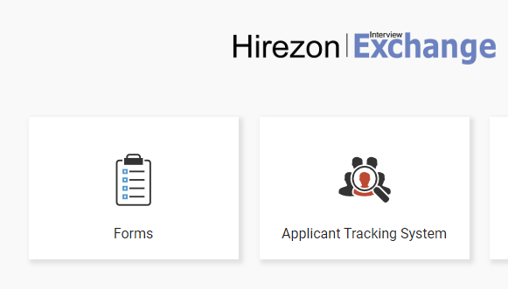
Click on Applicant Tracking System

Slide 3
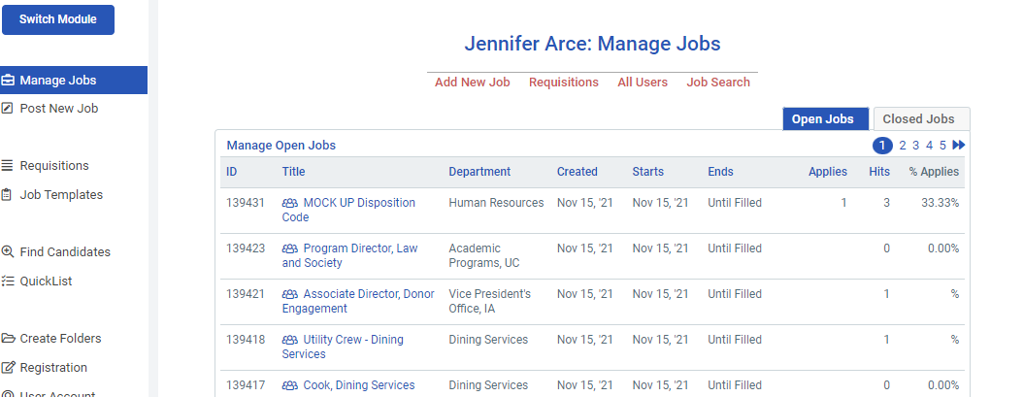
Click on the Job Title

Slide 4
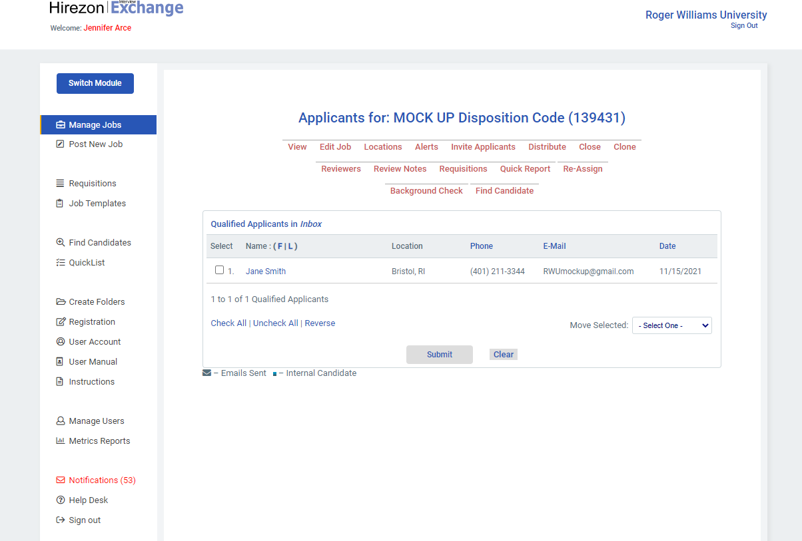
Click on Applicant Name

Slide 5
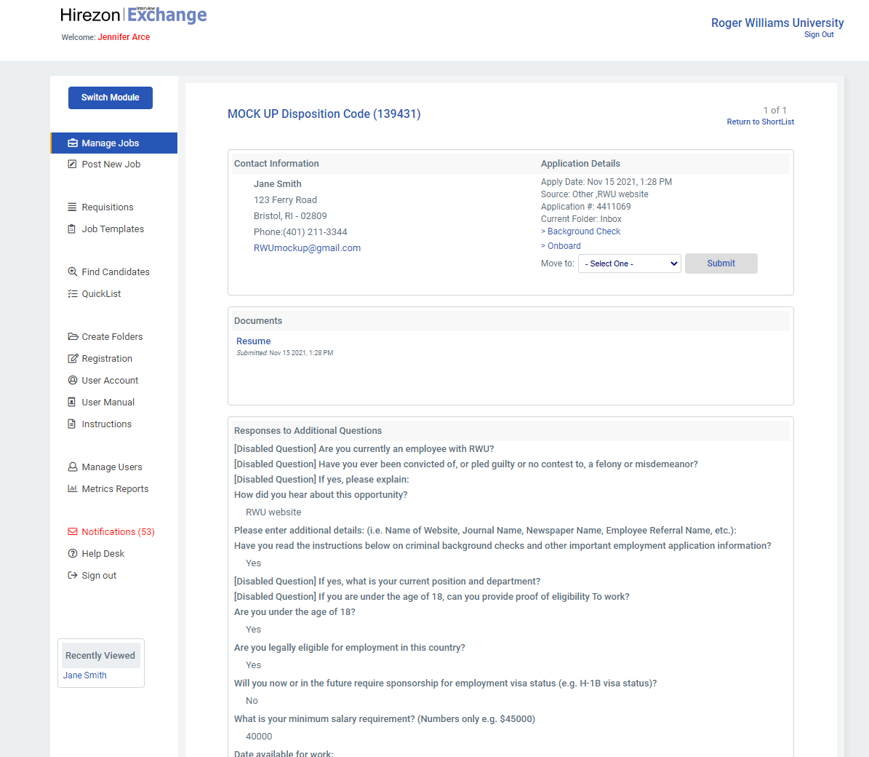
Applicant information will appear.
Proceed to scroll down to “Candidate Report Fields”

Slide 6
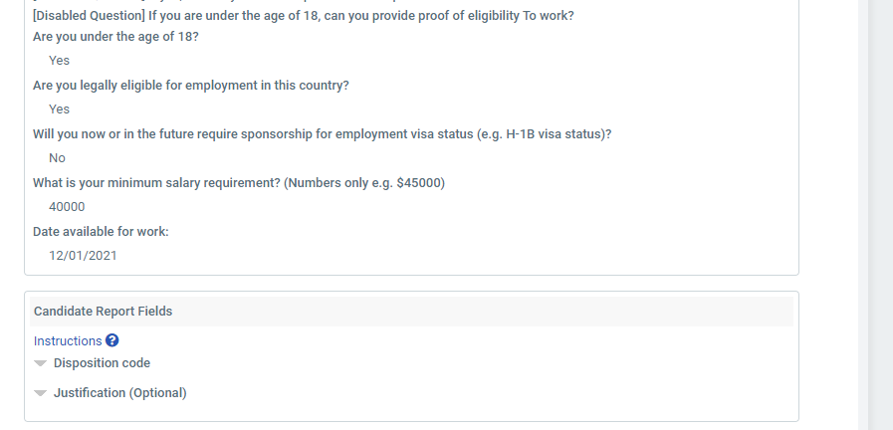
Click on Disposition Code

Slide 7
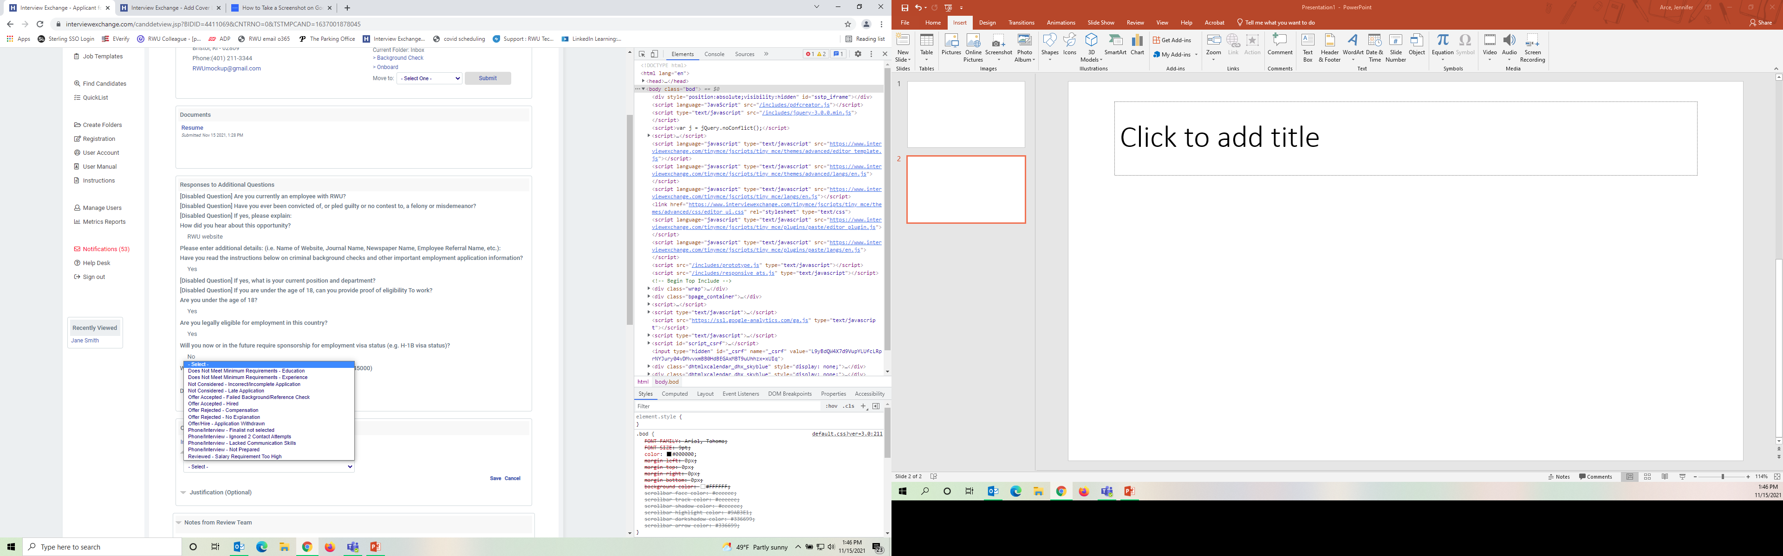
Selecting Disposition Code and Saving
STEP 2:
Click Save
STEP 1:
Select applicable Disposition Code for Applicant

Slide 8
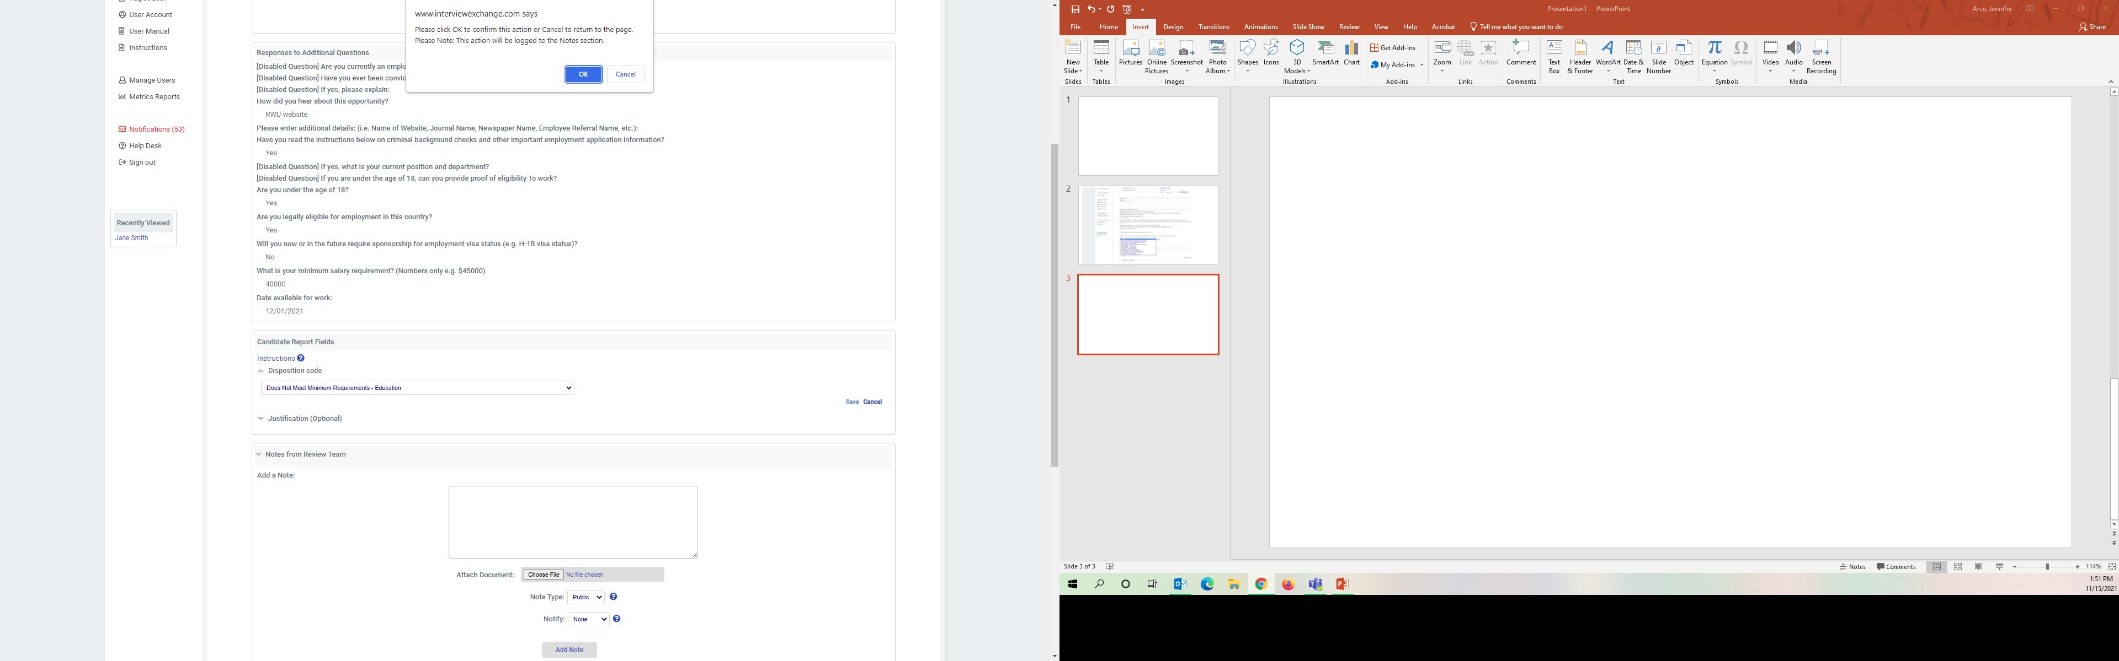
Click on OK to confirm

